Slide 1

Career Pathways:
They’re not just for career centers anymore!
North Union High School

Slide 2
Problem of Practice
New principal asking with great anticipation, “What are you going to do when you graduate?”
Graduate responding with total lack of enthusiasm, “I dunno…”

Slide 3
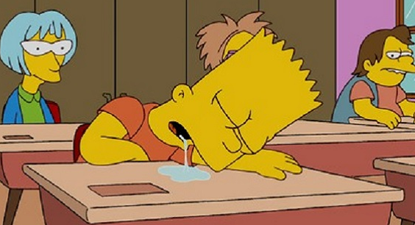

Is this the high school experience for students … and staff?
GROUNDHOG DAY!
Time for a CHANGE!

Slide 4
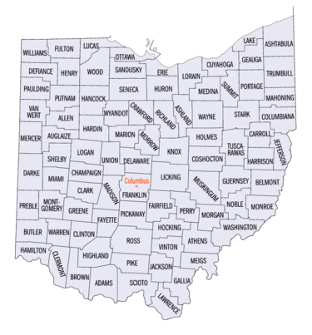
North Union School District
1550 Students/NUHS 470
Rural - yet 20 min to everything
Regional very low unemployment
Jobs are not in our district
45% Economically Disadvantaged
History of low career center enrollment
Notes:
Rich

Slide 5
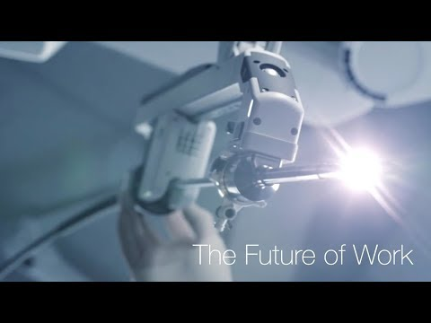
The New Economy
Notes:
Rich

Slide 6
Research to Inform Change
By 2025, 65% jobs require some type of postsecondary education or training.
Combination of education and technical training.
Current US college going rate is 66%. One quarter complete college degree.
Bounce back & college debt = lack of hope
Notes:
Rich

Slide 7
Research to Inform Change
Top earners with skills training outpace average wages of bachelor degree holders.
HIGH DEMAND Skilled Technicians: Healthcare, Engineering, STEM/Production Technicians, Business, IT, Skilled Trades
Benefit for special education students: ODE Report
Over the course of this longitudinal study, two clear predictors of postschool engagement for students with disabilities have emerged: participation in the general education classroom for more than 80 percent of the day and access to career-technical education.
xv Equity in Education January 2019
Notes:
Rich

Slide 8
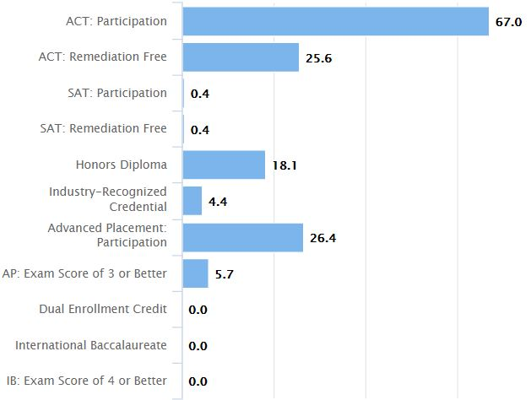
Prepared for Success?
Education should prepare children for life, but we have it backward. We prepare children’s lives for education.
Ted Dintersmith
What School Could Be
(2018)

Slide 9
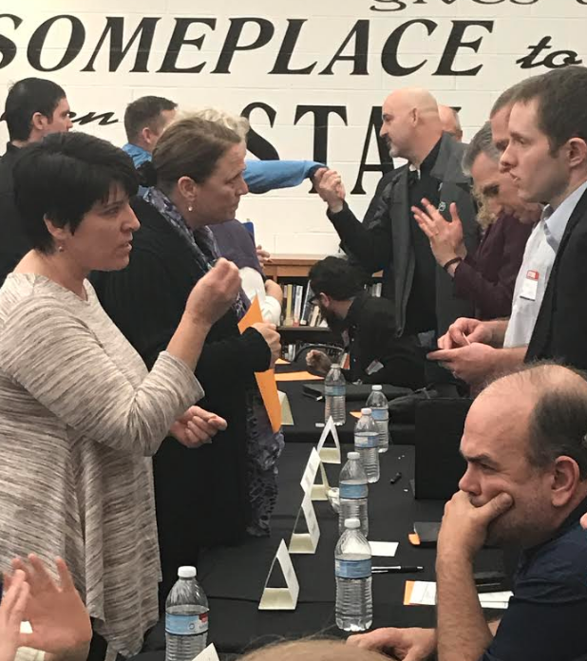
It took some convincing...
Expert Panel
Honda Manufacturing
CenturyLink
Richwood Bank
OSU Marion
Parrott Implement
Ken Davis & Sons
Ohio Carpenters Joint Apprenticeship
Memorial Hospital
Whirlpool
“I wish students left high school with…”
Notes:
Janel

Slide 10

What we learned...
Do our instructional practices promote employability skills?
Attendance
Drug Free
Eye Contact
Communication
Problem Solving
Collaboration
Get off your phone!
Knowledge &
Technical Skills
Notes:
Janel

Slide 11
Logo Created by Richwood Bank Marketing
Notes:
Janel

Slide 12
Grounded in Knowledge
Vision for North Union Graduates
Notes:
Janel

Slide 13
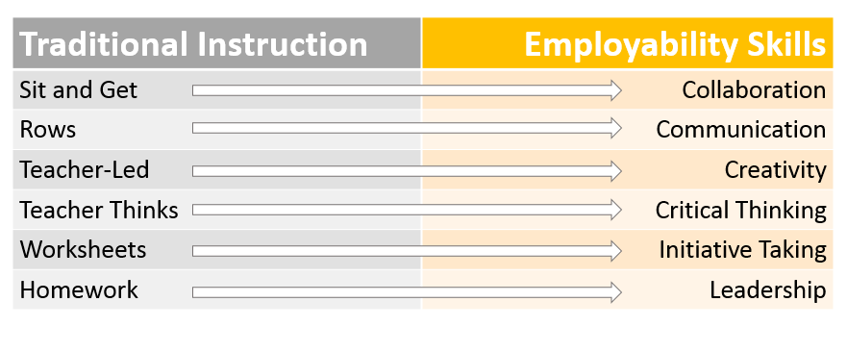
The need for instructional change…
Notes:
Janel

Slide 14








Notes:
Erika

Slide 15
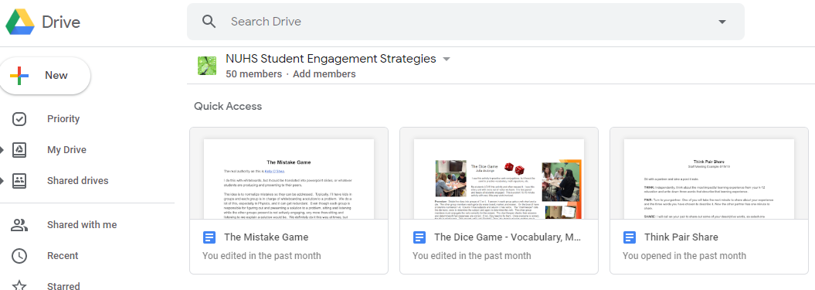
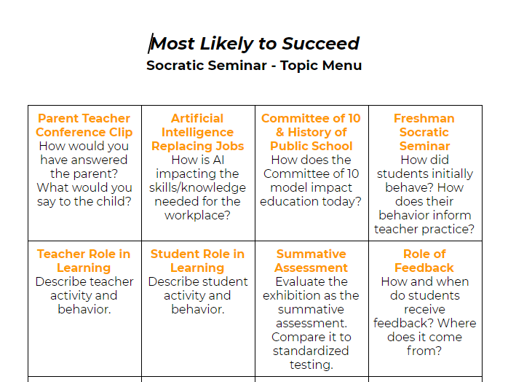
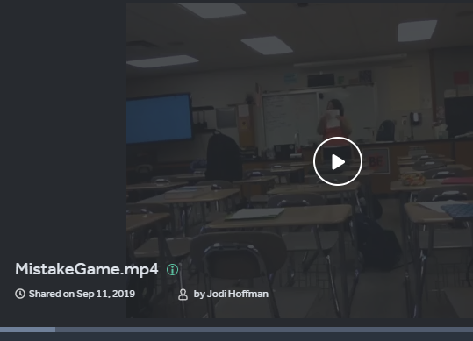
Digital Toolbox of Student Engagement Strategies

Slide 16
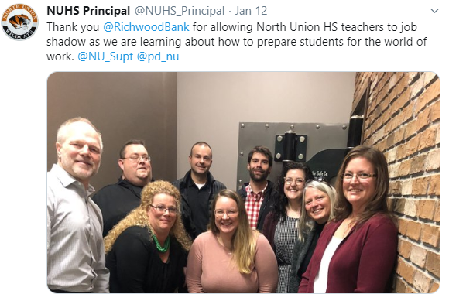
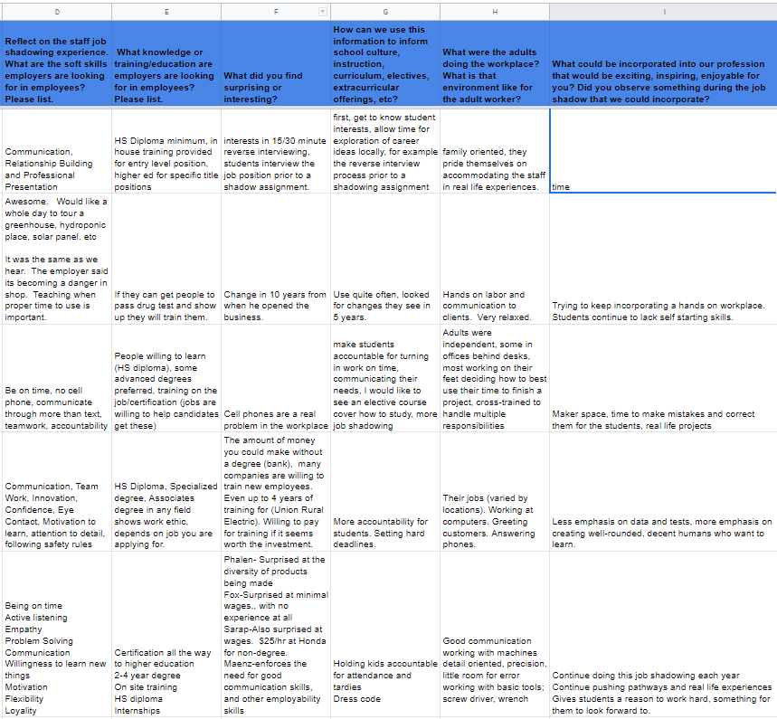
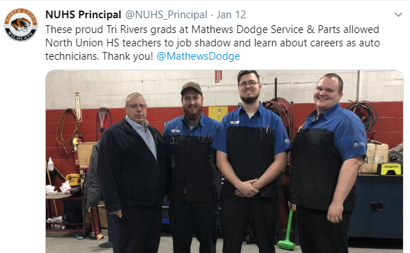
PLC Reflection Data
Staff Job Shadowing Experience -
Reinforcing the need for instructional change

Slide 17
Equipped for the World of Work
Vision for North Union Graduates

Slide 18
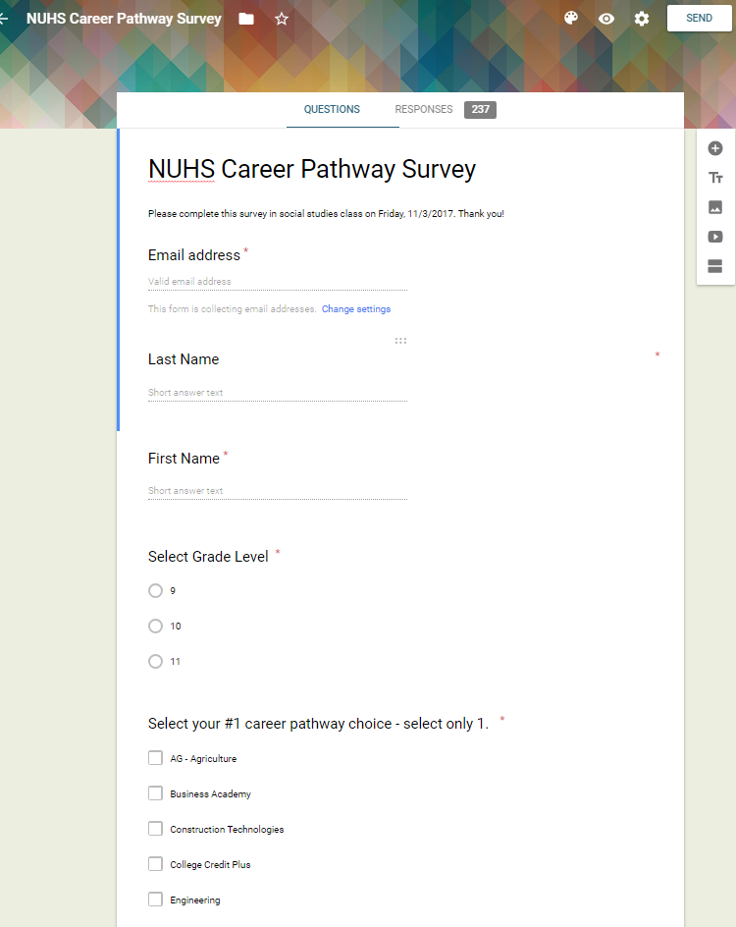
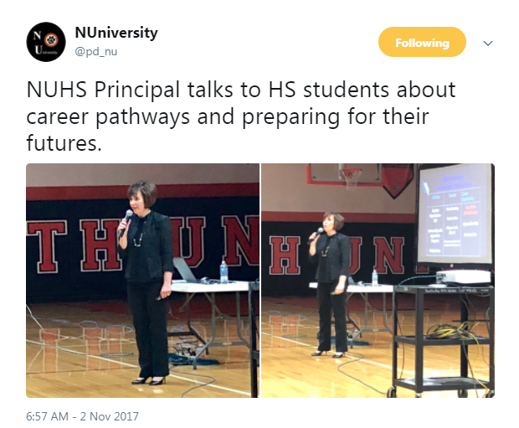
Inviting the Students
38% Healthcare
Professions
A complex idea can be conveyed with just a single still image, namely making it possible to absorb large amounts of data quickly.

Slide 19
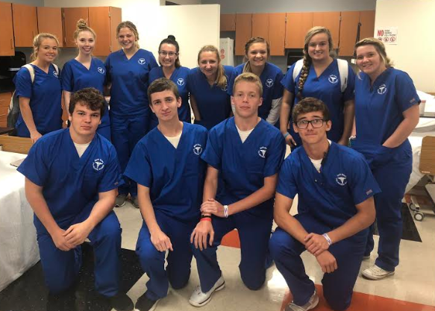
NEW Pre Nursing Pathway
Collaboration with Tri Rivers Career Center

Slide 20
Menu of Career Choices: Declare 1 Pathway
North Union High School
Agricultural & Environmental Systems
Business Administration
Engineering (Added 4th Course)
NEW - Pre Nursing
NEW - Construction Technology
MultiMedia
CCP Pathway - 15 credit hours
Tri Rivers Career Center
Engineering/Manufacturing
Nursing/Healthcare/Teaching
Cosmetology/Esthetics
Welding/Automotive/Construction
Criminal Justice
Culinary Arts
Increase in Career Center Attendance & Highest Enrollment in 18 yrs
NO early release unless enrolled in a career pathway course.

Slide 21

Career & Financial Choices - Graduation Required Course
Freshman
Career
Plan
Sophomore Career Day
JuniorAction
Plan
Senior
Principal Interview & Evidence

Slide 22
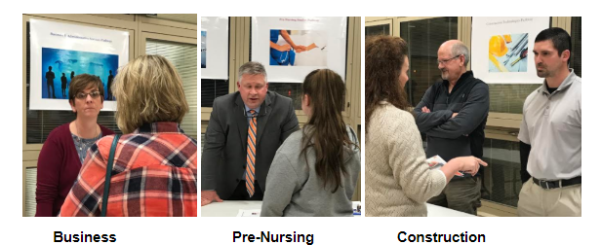
Communication with Parents & Community
Transferable Skills & Family Sustaining Wage

Slide 23

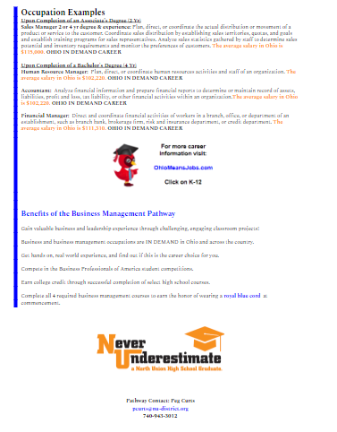
4 Course Completer = Cord at Graduation
Pathways aligned to Marion Technical College. Offer CCP & Ctag credit.

Slide 24




Collaboration is KEY!

Slide 25

Advisory & CTSO
Funding
Applying:
CTE 26
Teacher Credentials
WebXam &
Compliance
Learning the CTE Process

Slide 26
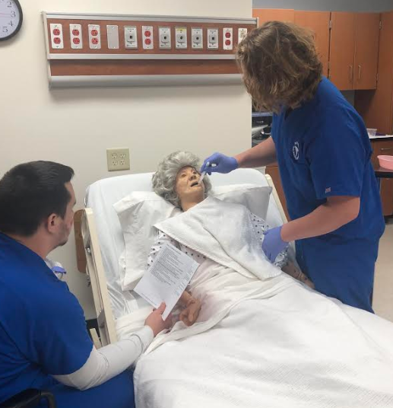
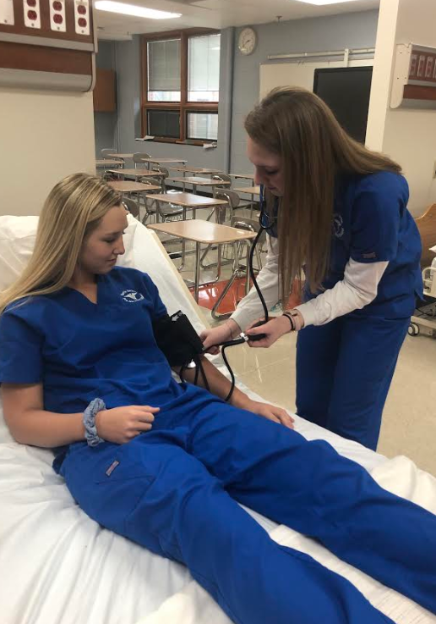
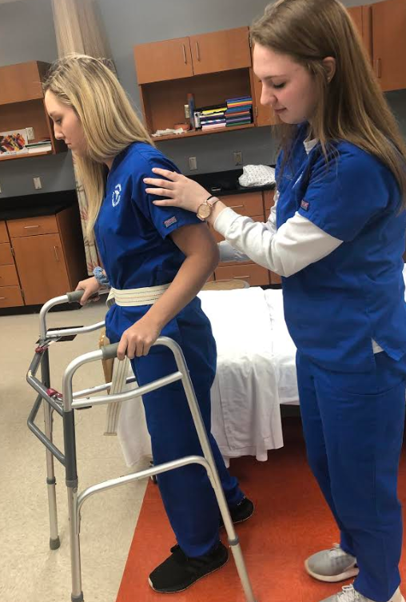
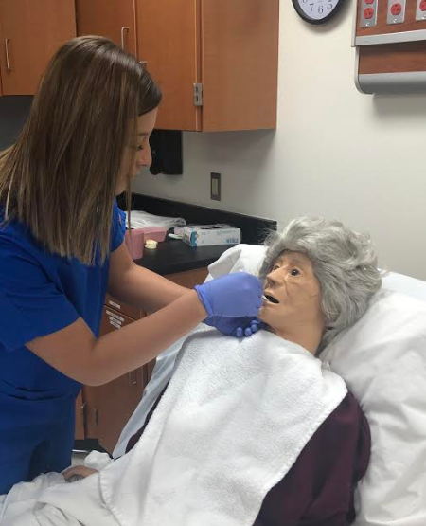
From Industry to the Classroom…

Slide 27
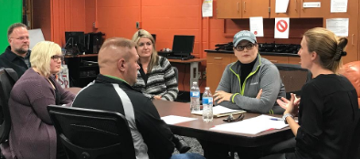
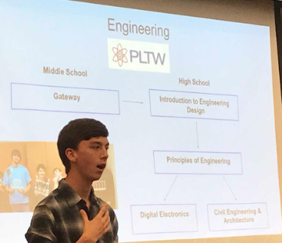
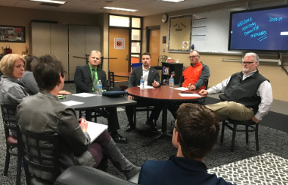

Business Advisory Council Meetings

Slide 28
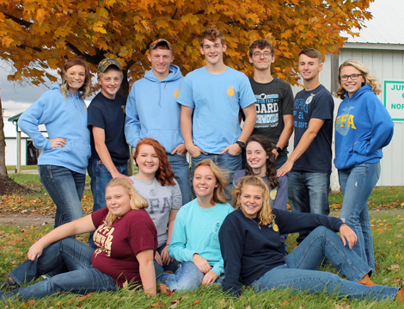
My daughter graduated from North Union. She was involved in many activities in high school, along with Student Council & FFA. During her FFA career, she challenged herself with public speaking. Public speaking is helping her today with her career. She works for a prominent company in Delaware Ohio. She teaches classes to employees & helps implement new procedures, along with many other things. She has traveled all over the Eastern United States. Today, she gave the opening speech to the president of the company. As a proud parent, I reflect back & realize that it all started in your classroom. Thank you for everything you do for our kids!!!
Career Technical Student Organizations

Slide 29
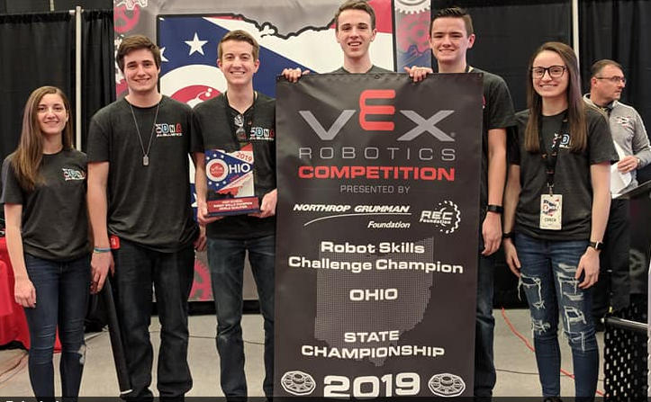
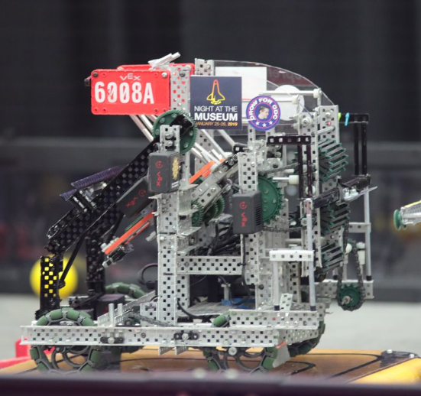
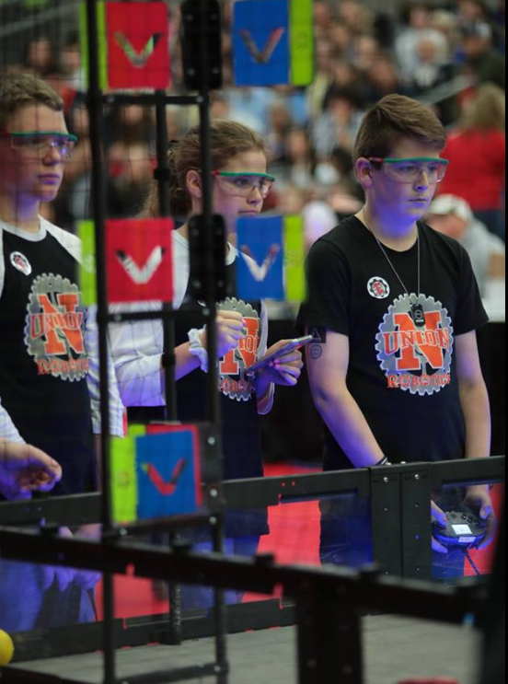
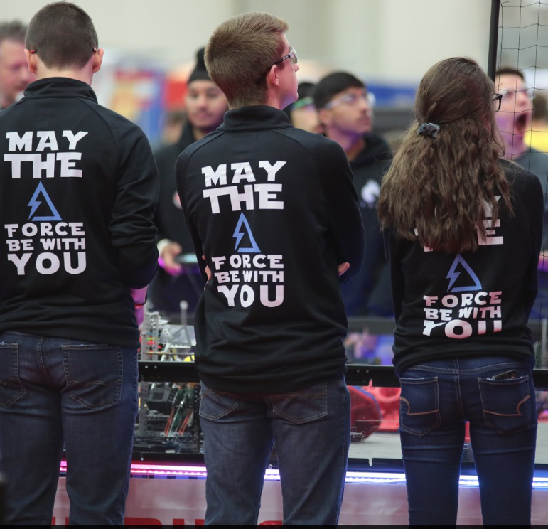

Career Technical Student Organizations

Slide 30

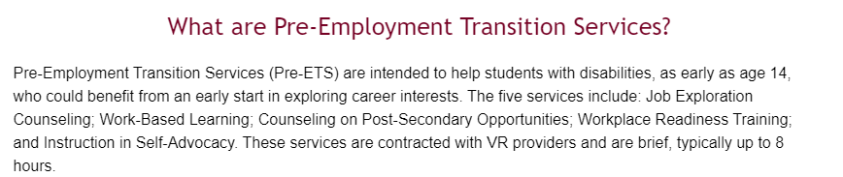

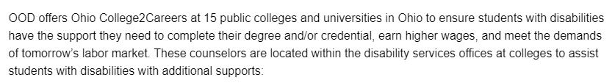
Empowering Ohioans with disabilities through employment, disability determinations, and independence.
Career & College Support for Students with Disabilities

Slide 31
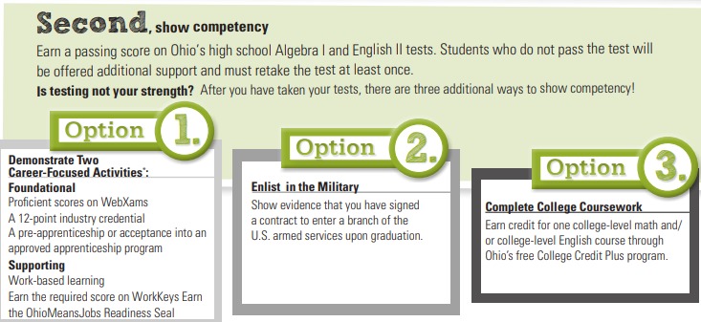
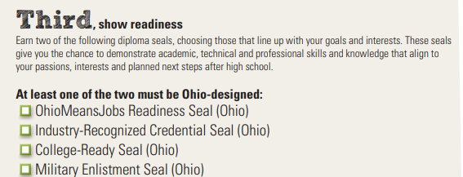

NEW Graduation Requirements - Class of 2023

Slide 32
Capable of Navigating the Future
Vision for North Union Graduates

Slide 33
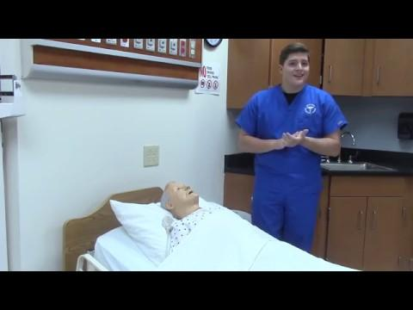

How has being a part of a career pathway impacted your high school experience and future career plans?

Slide 34
Next Steps

Slide 35
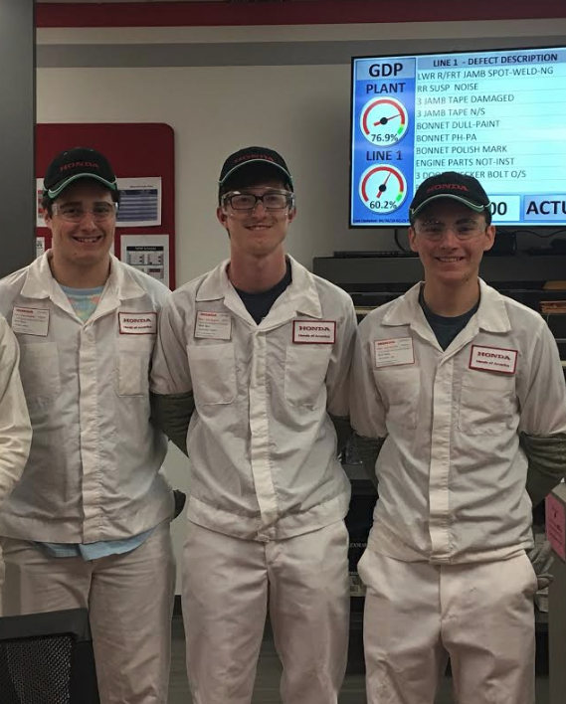
Next Steps
Internships
County-Wide Internship Collaborative
District Business Advisory
Real World Learning Opportunities
with Industry Partners
Makerspace Exploration
Drug Free Hire Me ™
Get the Word Out!
Communication plan to inform
parents about career opportunities

Slide 36
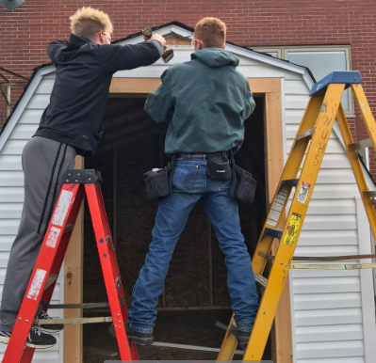

Next Steps
Offer industry credentials in every pathway
Ohio Career Readiness Seal

Slide 37
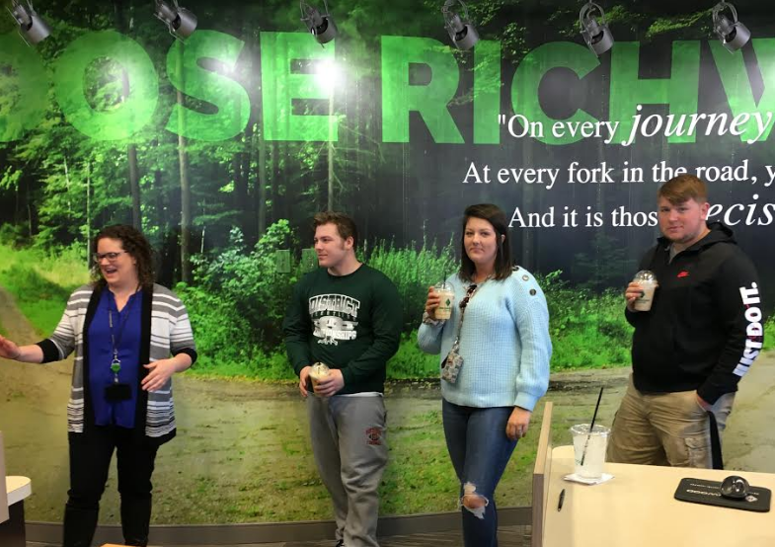
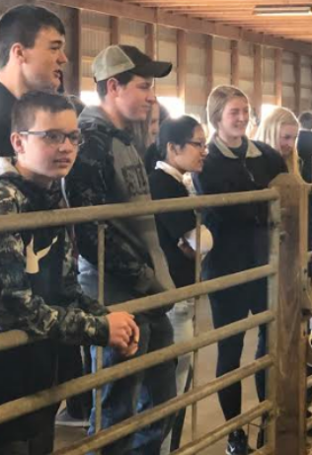
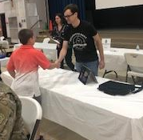
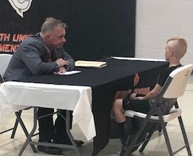
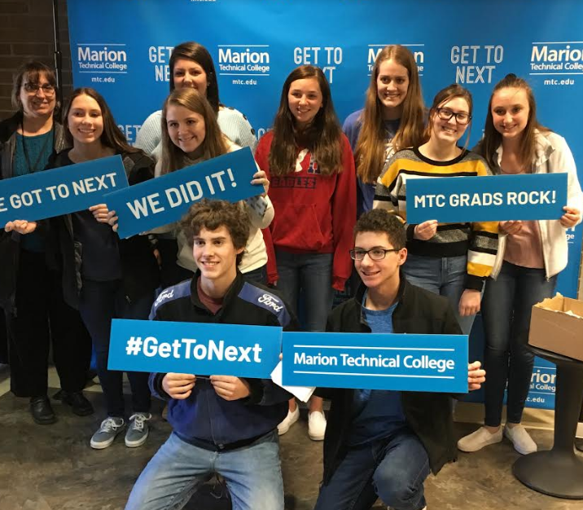
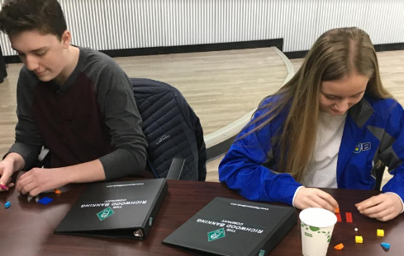
K-12 Career Programming

Slide 38
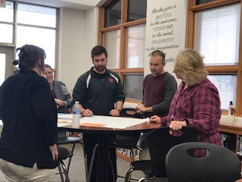
Job Embedded Learning & Instructional Focus
PLCs
Digital Toolbox
Evidence Based
Student Engagement
Employability Skills

Slide 39
Problem of Practice Answered!
Principal asking with great anticipation, “What are you going to do when you graduate?”
New graduate responds enthusiastically, “I am confident that I can execute my career plan, because I know my strengths and interests as they relate to my career choice. I know where to receive job training/education, and how to fund it. I know how to search for jobs, create a resume, and interview professionally. I have confidence in my ability to navigate the world of work due to my career pathway and real world learning experiences at North Union High School! I am excited and hopeful about my future!”

Slide 40
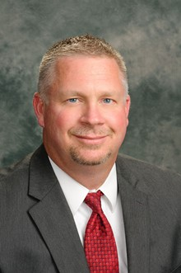
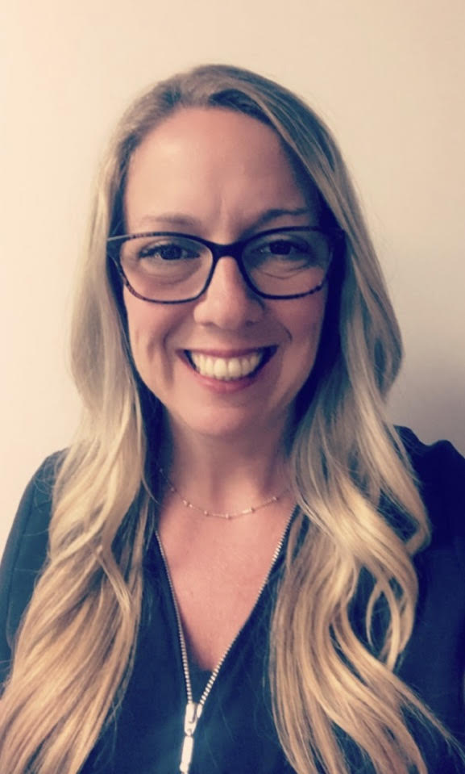
Contact
Rich Baird
Superintendent
North Union Schools
rbaird@nu-district.org
740-943-2509
Dr. Erika Bower
Chief Academic Officer
North Union Schools
ebower@nu-district.org
740-943-1602

Slide 41

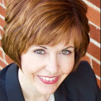
Contact
Janel Chapman
Principal
North Union High School
jchapman@nu-district.org
740-943-3012

